Slide 1
Property Rental Price Prediction Model
Army
20th Mar 2022

Slide 2
OUTLINE
Project Motivation
Exploratory Data Analysis
Modeling Methodology
Conclusion & Recommendation

Slide 3
Project Motivation

Slide 4
THE PROBLEM
2%
Inn the Neighborhood (client) is facing low conversion rate on rental webpage
Users are likely to leave the platform and not coming back
2 out of 100 people will sign up
Notes:
Our client is currently facing low conversion rate of only 2% on rental webpage, meaning that only 2 out of 100 ppl visiting the webpage will sign up. Meaning they will leave the platform and might not comeback again

Slide 5
THE SOLUTION
Build an app to estimate rental price from user input
Focus on short stays rental
Targeting less than $25 prediction error
Notes:
To solve the problem, comes the idea Building an app to estimate rental price from user input
We will focus on short stays rental, targeting less than $25 prediction error

Slide 6
Exploratory Data Analysis

Slide 7
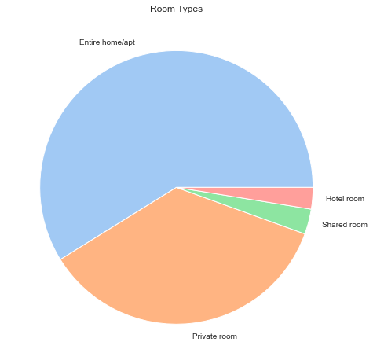
ROOM TYPES
4 Room types
Highest – Entire home/apt
Proportion looks good

Slide 8
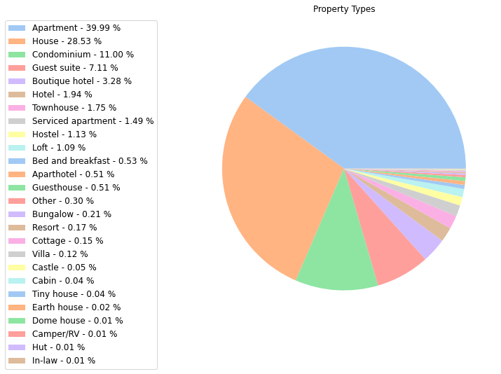
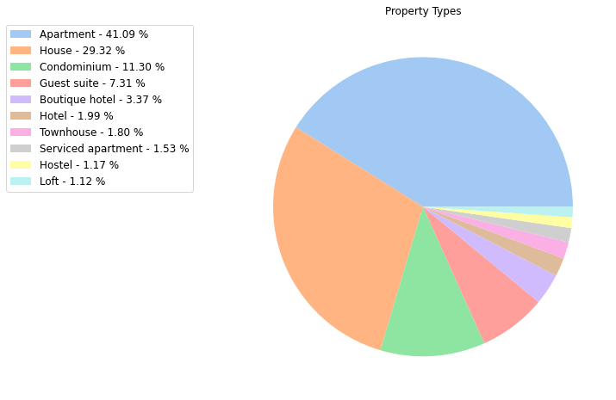
PROPERTY TYPES
Too many types!
Removed types with 1% or less
Notes:
There are too many property types and many types with minor population that we can’t even see what they are!
After removing, we have 10 property types remain, the highest in population is apartment, and the proportion looks better

Slide 9
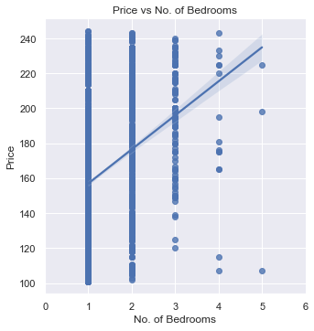
PRICE VS BEDROOMS
Correlation coefficient = 0.3
The graph has positive correlation
More bedrooms is likely to have higher price
Notes:
Now we let’s see the relationship between price and no. of bedrooms
So, you can say that property with high bedrooms will have higher price

Slide 10
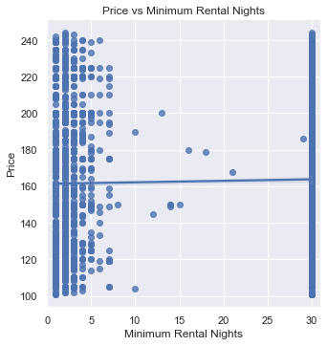
POPULAR MINIMUM NIGHTS
Correlation coefficient = 0
No correlation between price and minimum nights
Popular minimum nights are between 1 – 5 nights and 30 nights

Slide 11
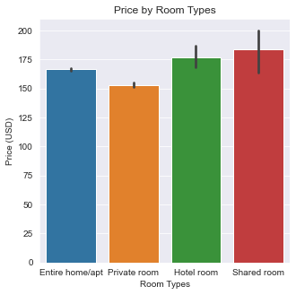
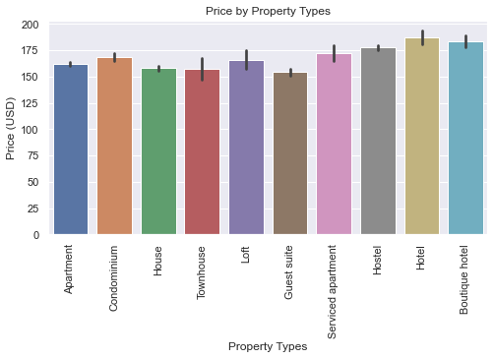
PRICE VS CATEGORY
Shared room & hotel room is likely to have high price
Hotel is likely to have highest price

Slide 12
Modeling Methodology

Slide 13
METHODOLOGY
Regression model – predict continuous numeric value
Fit the data to 5 algorithms and select the one with least error
Notes:
According to the problem, we will use regression model, which is basically a model that use features to predict continuous value – in this case, the rental price

Slide 14
MODEL SELECTION
Best model is Random Forest
Error already meets the target
After tuning, we got around $24.5 error
Model | MAE
Ridge | 26.5446
DecisionTree | 31.9653
RandomForest | 24.7099
GradientBoosting | 25.2143
SVM | 25.9565
Notes:
MAE – the difference of prediction and actual value

Slide 15
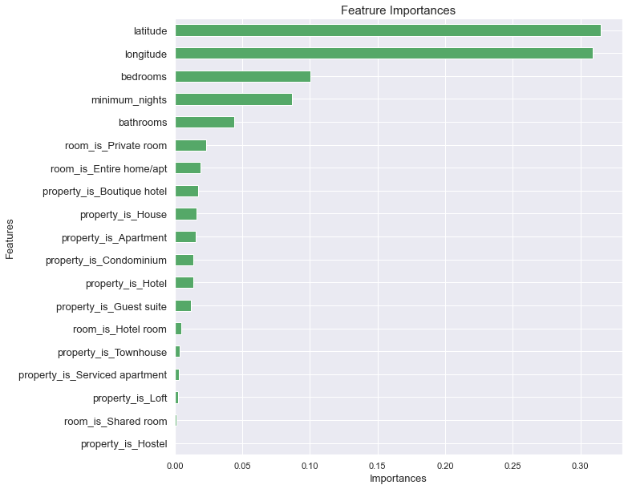
IMPORTANT FEATURES
As we saw earlier, no. of bedrooms in one of the most important features
Surprisingly, location is the most important feature

Slide 16
Conclusion & Recommendation

Slide 17



CONCLUSIONS
1-5
30
Location has the most impact on price
More bedrooms More money
Popular minimum nights is between 1 – 5 and 30

Slide 18
RECOMMENDATIONS
Reduce number of property types or group some similar types together - reduce chance of minor categories
Explore more on impact of location by creating a visual on rental price and location on a real map
Remove overpriced places from the analysis
Further tuning of the model

Slide 19
THANK YOU!

